Slide 1
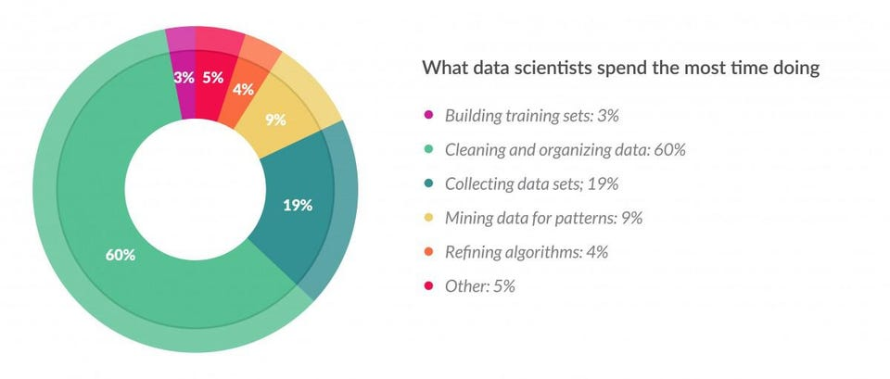
Image by Gil Press on Forbe: https://www.forbes.com/sites/gilpress/2016/03/23/data-preparation-most-time-consuming-least-enjoyable-data-science-task-survey-says/?sh=87aef4e6f637
Inefficiency In Data Science Methodology

